Slide 1
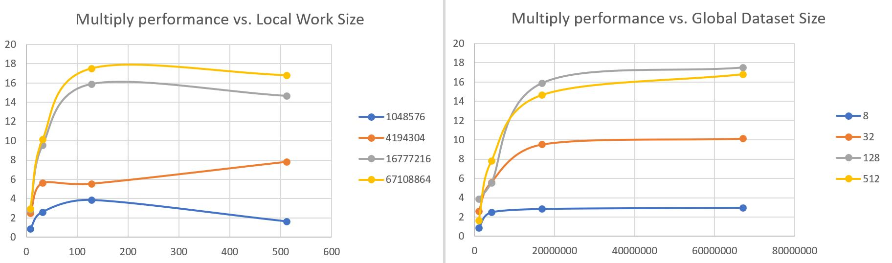
GigaMultsPerSecond
GigaMultsPerSecond
Global Dataset Size
Local Work Size
Local Work Size
Global Dataset Size

Slide 2
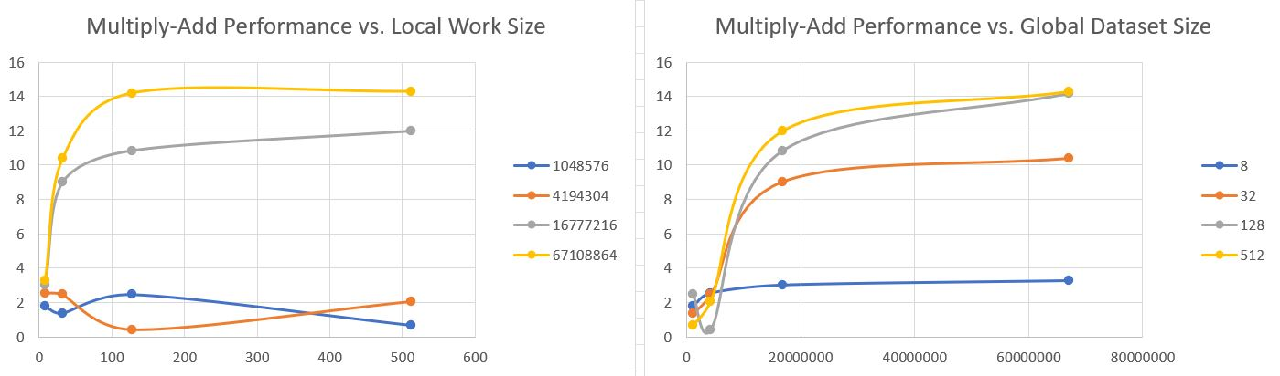
GigaMultsPerSecond
GigaMultsPerSecond
Global Dataset Size
Local Work Size
Local Work Size
Global Dataset Size

Slide 3
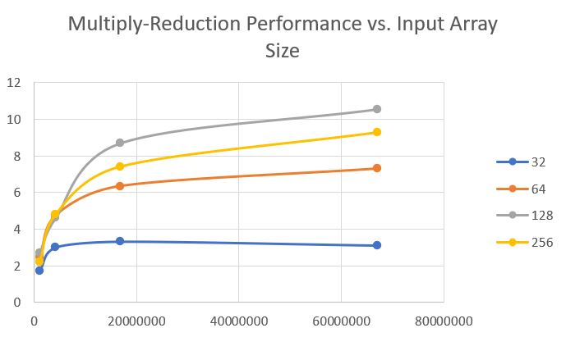
GigaMultsPerSecond
Local Work Size
Input Array Size

